Slide 1
Serverless Design Patterns
Pravin Y Pawar

Slide 2

Serverless Patterns
Many design patterns exists for Serverless
Commonality is the fundamental combination of an event trigger and business logic
Patterns
Scheduling
Command and Query Responsibility Segregation (CQRS)
Event-based processing
File triggers and transformations
Web apps and APIs
Data pipeline
Stream processing
API gateway
source : Serverlesslife

Slide 3
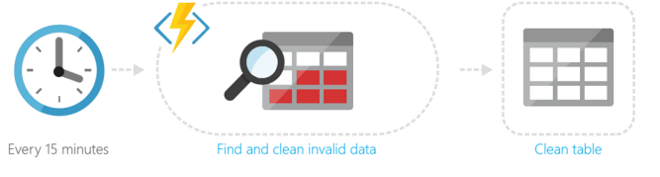
Scheduling
Scheduling tasks is a common function
Diagram shows a legacy database that doesn’t have appropriate integrity checks
The database must be scrubbed periodically
The serverless function finds invalid data and cleans it
The trigger is a timer that runs the code on a schedule
Source : Microsoft

Slide 4
Command and Query Responsibility Segregation (CQRS)
A pattern that provides different interfaces for reading (or querying) data and operations that modify data
Problems in Older system
In traditional Create Read Update Delete (CRUD) based systems, conflicts can arise from high volume of both reads and writes to the same data store
Locking may frequently occur and dramatically slow down reads
Often, data is presented as a composite of several domain objects and read operations must combine data from different entities
Using CQRS
Read might involve a special “flattened” entity that models data the way it’s consumed
Read is handled differently than how it’s stored
For example,
Database may store a contact as a header record with a child address record
Read could involve an entity with both header and address properties
It might be materialized from views
Update operations could be encapsulated as isolated events that then trigger updates to two different models
Separate models exist for reading and writing

Slide 5
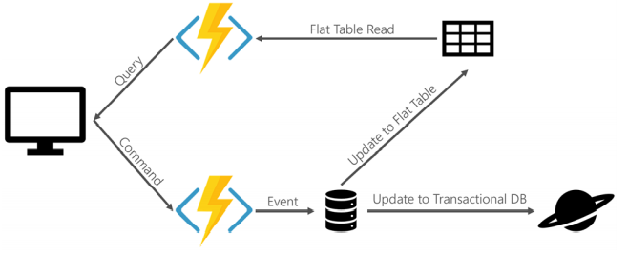
Command and Query Responsibility Segregation (CQRS) -2
Source : Microsoft

Slide 6
Event-based processing
Events are informational messages
In message-based systems, events are often collected in queues or publisher/subscriber topics to be acted upon
These events can trigger Serverless functions to execute a piece of business logic
Example of event-based processing is event-sourced systems
An “event” is raised to mark a task as complete
A Serverless function triggered by the event updates the appropriate database document
A second Serverless function may use the event to update the read model for the system

Slide 7
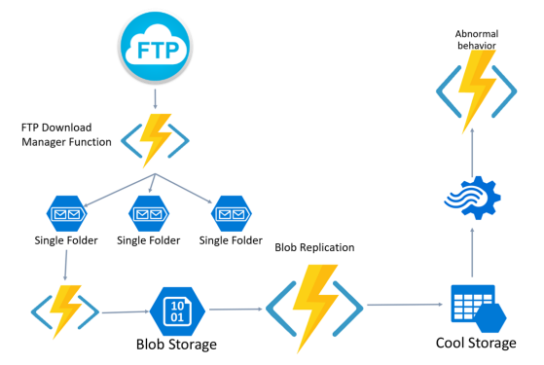
File triggers and transformations
Extract, Transform, and Load (ETL) is a common business function
Serverless is a great solution for ETL because it allows code to be triggered as part of a pipeline
Individual code components can address various aspects
One Serverless function may download the file
Another applies the transformation
Another loads the data
The code can be tested and deployed independently, making it easier to maintain and scale where needed.
Source : Microsoft

Slide 8
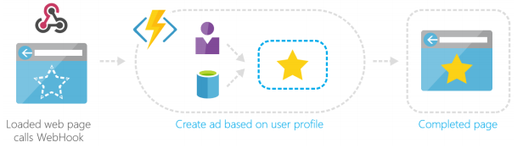
Web apps and APIs
A popular scenario for serverless is N-tier applications
most commonly ones where the UI layer is a web app
The popularity of Single Page Applications (SPA) has surged recently
SPA apps render a single page, then rely on API calls and the returned data to dynamically render new UI without reloading a full page
Client-side rendering provides a much faster, more responsive application to the end user
Serverless endpoints triggered by HTTP calls can be used to handle the API requests
For example,
Ad services company may call a serverless function with user profile information to request custom advertising
The serverless function returns the custom ad and the web page renders it
Source : Microsoft

Slide 9
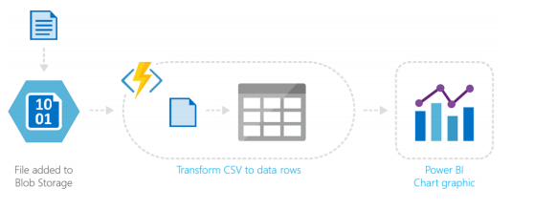
Data pipeline
Serverless functions can be used to facilitate a data pipeline
For example,
A file triggers a function to translate data in a CSV file to data rows in a table
The organized table allows a BI dashboard to present analytics to the end user
Source : Microsoft

Slide 10
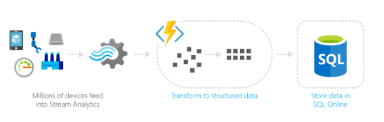
Stream processing
Devices and sensors often generate streams of data that must be processed in real time
There are a number of technologies that can capture messages and streams from Event Hubs and IoT Hub to Service Bus
Regardless of transport, serverless is an ideal mechanism for processing the messages and streams of data as they come in
Serverless can scale quickly to meet the demand of large volumes of data
The serverless code can apply business logic to parse the data and output in a structured format for action and analytics
Source : Microsoft

Slide 11
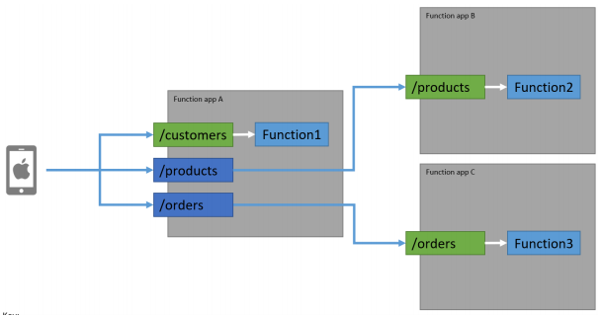
API gateway
An API gateway provides a single point of entry for clients
then intelligently routes requests to back-end services
useful to manage large sets of services
can also handle versioning and simplify development by easily connecting clients to disparate environments
Serverless can handle back-end scaling of individual microservices while presenting a single front end via an API gateway
Source : Microsoft

Slide 12
Thank You!
Reference:
Serverless apps Architecture patterns and Azure implementation
By Microsoft
In our next session:

